Slide 1
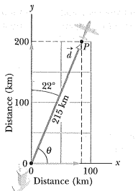
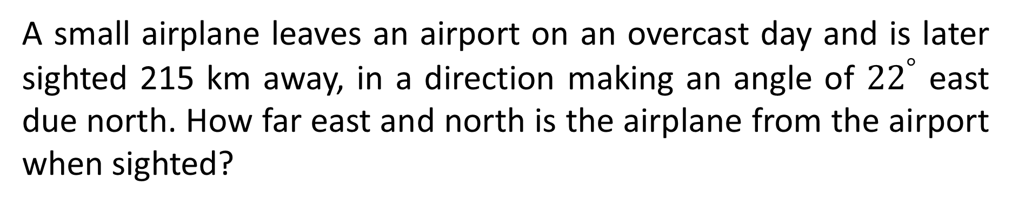
A small airplane leaves an airport on an overcast day and is later sighted 215 km away, in a direction making an angle of ${22}^{°}$ east due north. How far east and north is the airplane from the airport when sighted?
ANS: East 81 km; north 199 km

Slide 2
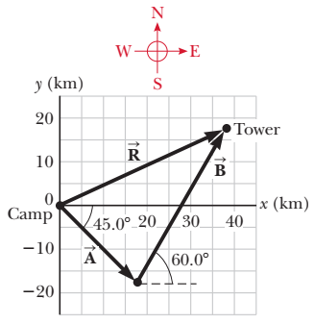
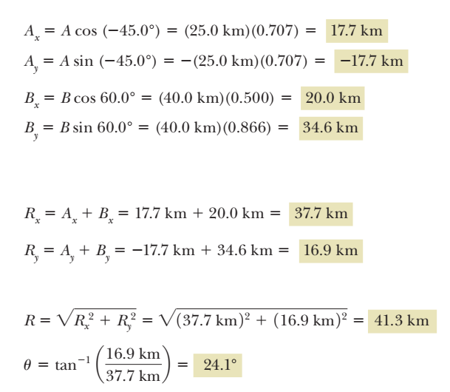
A hiker begins a trip by first walking 25.0 km 45.0° south of east from her base camp. On the second day she walks 40.0 km in a direction 60.0° north of east, at which point she discovers a forest ranger’s tower. (a) Determine the components of the hiker’s displacements in the first and second days. (b) Determine the components of the hiker’s total displacement for the trip. (c) Find the magnitude and direction of the displacement from base camp.

Slide 3
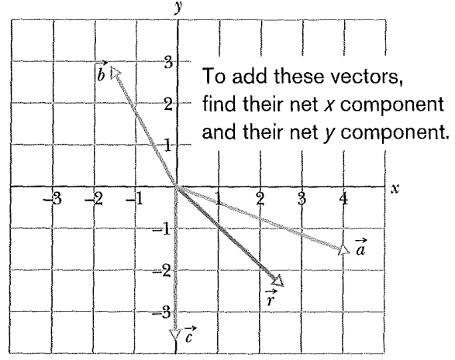

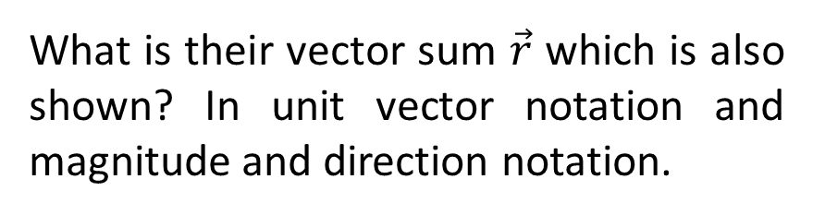


$$\vec{a}=\left(4.2 m\right)\hat{i}−(1.5 m)\hat{j}$$
$$\vec{b}=\left(−1.6 m\right)\hat{i}+(2.9 m)\hat{j}$$
$$\vec{c}=\left(−3.7 m\right)\hat{j}$$
What is their vector sum $\vec{r}$ which is also shown? In unit vector notation and magnitude and direction notation.
What is the angle $φ$ between $\vec{a}=3.0\hat{i}−4.0\hat{j}$and $\vec{b}=−2.0\hat{i}+3.0\hat{k}$ ?

Slide 4

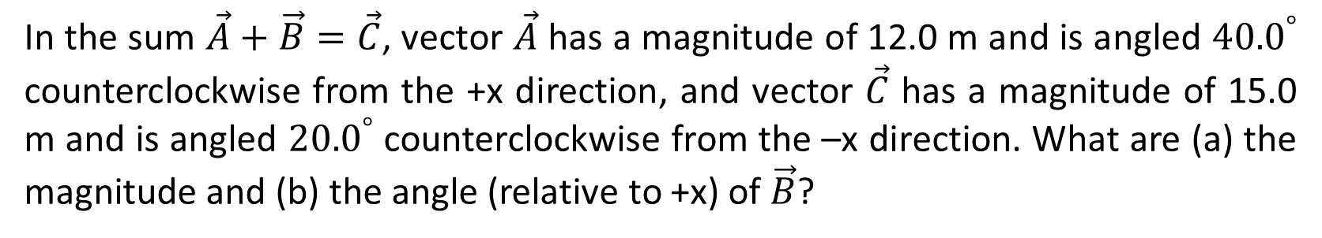
In the sum $\vec{A}+\vec{B}=\vec{C}$, vector $\vec{A}$ has a magnitude of 12.0 m and is angled ${40.0}^{°}$ counterclockwise from the +x direction, and vector $\vec{C}$ has a magnitude of 15.0 m and is angled ${20.0}^{°}$ counterclockwise from the –x direction. What are (a) the magnitude and (b) the angle (relative to +x) of $\vec{B}$?
The angle between $\vec{C}$ and +x axis is ${20.0}^{°}+{180.0}^{°}={200.0}^{°}$
$$B_{x}=C_{x}−A_{x}=−23.3 m$$
$$B_{y}=C_{y}−A_{y}=−12.8 m$$

Slide 5
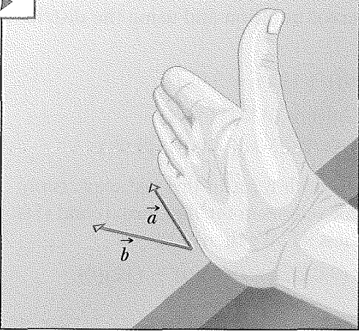
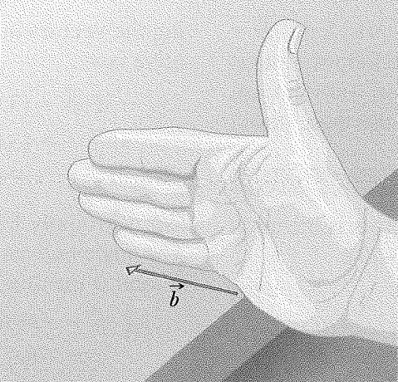
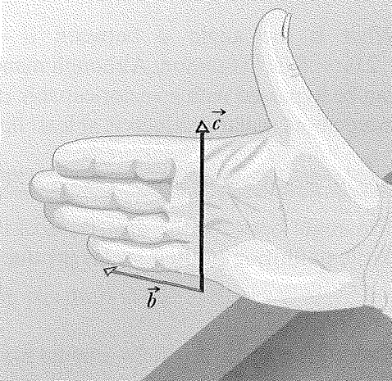
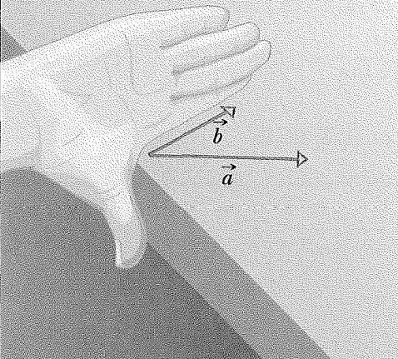
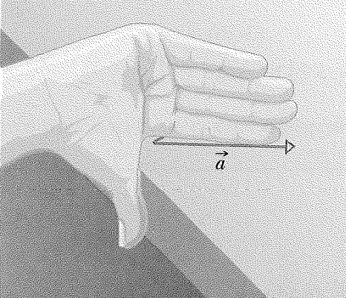
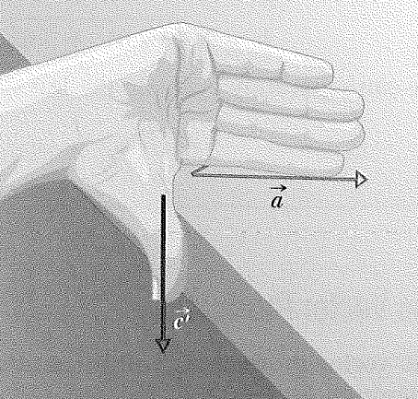

Slide 6
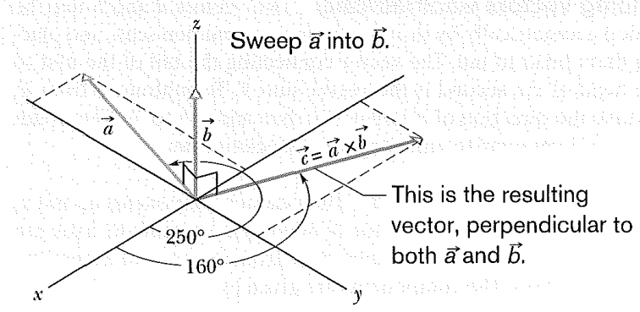
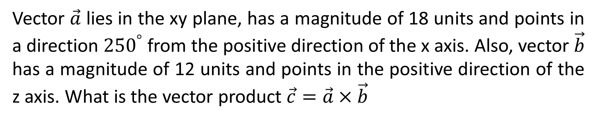
Vector $\vec{a}$ lies in the xy plane, has a magnitude of 18 units and points in a direction ${250}^{°}$ from the positive direction of the x axis. Also, vector $\vec{b}$ has a magnitude of 12 units and points in the positive direction of the z axis. What is the vector product $\vec{c}=\vec{a}×\vec{b}$

